Slide 1
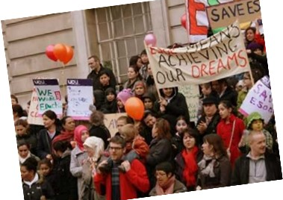
Linguistic citizenship & adult migrant education: voice, linguistic diversity, and sociolinguistic understanding in education
Melanie Cooke
King’s College, London
NEXUS: The Belonging Research Network
27th June 2023
Contact: melanie.cooke@kcl.ac.uk

Slide 2
Outline
Linguistic citizenship (Stroud, 2001, 2018) ‘a blueprint for a conceptual space within which to think differently – politically and ethically – about language and about ourselves’ (Stroud 2018)
Localising linguistic citizenship
Linguistic citizenship and language education: how the sociolinguistic and citizenship concerns of migrant communities and individuals in the UK are being addressed in ESOL
Future developments?

Slide 3
Collaborators
The Hub for Language and Education Diversity (HELD) at King’s College London & English for Action (EFA)
People:
Ben Rampton (KCL)
Constant Leung (KCL)
Anthony Tomei (KCL and Bell Foundation)
Dermot Bryers (EFA)
Becky Winstanley (EFA and SOAS)
Plus: many other teachers, students and other collaborators

Slide 4
Problems with ‘citizenship’
Multivalent, contested term
Nation-states: reinvesting in the idea of citizenship as a form of bio-political governance.
Neoliberalism has hollowed out democracy, cultivating consumer-citizens who are less likely to actively participate in political/civic/community life
Citizenship shaped by inequalities of status and power

Slide 5
Citizenship theory: useful ideas
Citizenship as status (something we have) vs citizenship as practice (something we do)
Opens up the possibility of non-state-centric, non-mandated forms of citizenship – citizenship as a democratic, dialogic, participatory process
Dis-citizenship (Pothier and Devlin, 2006; Ramanathan 2013)
draws attention to the ways in which our capacity for citizenship can be stripped away by non-recognition, stigmatization or discrimination, and so result in second-class citizenship or straightforward exclusion
Acts of citizenship (Isin 2008)
public acts through which individuals or groups contest their exclusion and claim new citizenship rights

Slide 6
Brokering Britain, Educating Citizens
Citizenship as a useful heuristic for ESOL work?
Case studies: explored ESOL as a site for developing the capacity of diasporic citizens to participate in political and community life, to contribute to the formation of a pragmatic ‘common language’, whilst resisting dis-citizenship and engaging in acts of citizenship, regardless of formal status.

Slide 7
Activity
How is ‘citizenship’ understood in your contexts?
What are the areas of tension or contestation?

Slide 8
Linguistic citizenship vs Language Human Rights
LHR:
provision for a specific group, usually designed to overcome historical disadvantage;
the incorporation of this group’s distinctive language as an entitlement in institutional activity;
an expectation that the courts and other bodies overseeing the nation state will grant and monitor this (Stroud 2001)

Slide 9
Problems with LHR
it marginalizes people who use non-standard versions of the group’s language, generating new sociolinguistic inequalities;
it promotes an arbitrary essentialist view of language and ethnicity because it creates artificial boundaries between ways of speaking that are continuous and overlooks mixing and hybridity;
it appeals to a top-down managerial politics;
it presupposes membership of a single state;
it neglects population mobility.

Slide 10
Linguistic citizenship
puts democratic participation first, emphasizing cultural and political voice and agency rather than just language on its own;
sees a variety of linguistic practices – including those seen as mixed, low status or transgressive – as potentially relevant to social and economic wellbeing;
stresses the importance of grassroots activity on the ground, often on the margins of state control, outside formal institutions.
Stroud & Heugh (2004) contend that ‘an enhanced understanding of sociolinguistic processes should be central to emancipatory politics’

Slide 11
Academic and pedagogic alignments
Dell Hymes (1977): the careful comparative study of communicative repertoires and practices ultimately serves the higher ethical goals of Liberté, Égalité, Fraternité because it prepares us to speak concretely to actual inequalities.
The intellectual deconstruction of ‘named languages’ that is now mainstream in sociolinguistics and linguistic anthropology, i.e. which challenges the belief that distinct languages exist as natural objects such as ‘English’ ‘German’ ‘Cantonese’ – viewing them instead as social, ideological constructs.
Ideas in language education about translanguaging, i.e. that we all communicate using multiple linguistic and semiotic resources
Participatory pedagogy: socially committed teaching which starts with the concerns of the students

Slide 12
Localising Linguistic Citizenship
Linguistic Citizenship is a Southern and decolonial concept arising from contradictions surrounding educational programmes in the global South (Stroud 2018:18)
The relevance of the concept of Linguistic Citizenship is being discussed elsewhere, i.e. in South East Asia (see Lim et al 2019), Europe, including the UK (see our work and e.g. Gspandl et al 2023) and Israel (see Awayed-Bishara 2021)
‘the concept of linguistic citizenship permits multiple (democratic participatory) approaches to citizenship issues based on an idea of language as a political and economic site of struggle, on respect for language diversity and difference and on the deconstruction of essentialist understandings of language and identity’ (Stroud 2001: 353)

Slide 13
Multilingualism in the UK
South Africa and UK: very different but both are superdiverse, highly multilingual societies: in London in 2021, 57% of new babies had a non-UK born mother; 20% of English primary school children use a language other than English at home
‘a South… also exists in the global North, in the form of excluded, silenced and marginalized populations’ (Santos 2012:51)
In the UK many citizens have language repertoires that involve the kind of variety and mixing that Stroud et al describe; many of the concepts in linguistic citizenship are very well suited to the multilingualism of everyday urban life in the UK

Slide 14
Despite this:
Drastic decline in numbers studying languages at secondary school and university
Disconnect between mainstream education and community-based language learning; complementary/supplementary schools have very little visibility
EAL (schools): no co-ordinated national provision and no teacher education
ESOL (adults): provision is fragmented, demand outstrips supply, funding cut by 60% since 2010

Slide 15
And…
The British nation-state’s response to multilingualism is an insistence that immigrants need to learn English for social cohesion and national security, and that a lack of English increases the threat of radicalization and terrorism, particularly amongst Muslims
2002 Nationality, Immigration and Asylum Act ‘Life in the UK’ test and language testing for those wishing to gain British nationality and in 2007 to all those applying for Leave to Remain (residence)
Central government is explicit about making Brexit Britain ‘a hostile environment’ for migrants across a range of policy areas

Slide 16
Activity
What are the language issues where you are?

Slide 17
Contesting monolingualism in the UK
Scotland and Wales where bilingualism is officially recognised and where ESOL is more systematically organised
Rampton et al (2023) outline several other sources and resources contesting England’s monolingualism:
Civil society
State education in the 1960s-80s
Academic research
Universities
Some language education today

Slide 18
The work of the Hub for Education and Language Diversity (HELD)
Three guiding principles:
Shared language is vital to social life, but linguistic diversity is also central. Both can be enhanced by education, enriching both the individual and society.
Local conditions and participant perspectives really matter.
Theories and research can be powerful tools, helping people to think differently.

Slide 19
HELD activities
Research
Materials development
Publishing
Active links with other universities (UWC, Upenn, Monash)
HE teaching
Teacher training/CPD
Work in classrooms

Slide 20
Acts of citizenship (Isin 2008)
Public acts through which individuals or groups contest their exclusion and claim new citizenship rights and recognition
Can be overtly political/’activist’ or take place in interactions in everyday settings such as public transport, or be enacted in ordinary ways, such as talking back in response to an insult or other offence.
Communication: central to the capacity of individuals and groups to carry out acts of citizenship of both types
ESOL has a clear role in assisting students to develop these capacities

Slide 21
Political acts of citizenship around language
English for Action is an educational charity which provides ‘accessible, participatory, and empowering’ English language classes for migrants in London. They campaign on issues affecting migrants, support students to speak up on issues that impact them and train other ESOL teachers in their approach.
Example:
#LoveESOL, a coalition of 39 organisations, including many students, has been working for some years to influence the Greater London Authority to improve ESOL funding and organisation in the capital

Slide 22
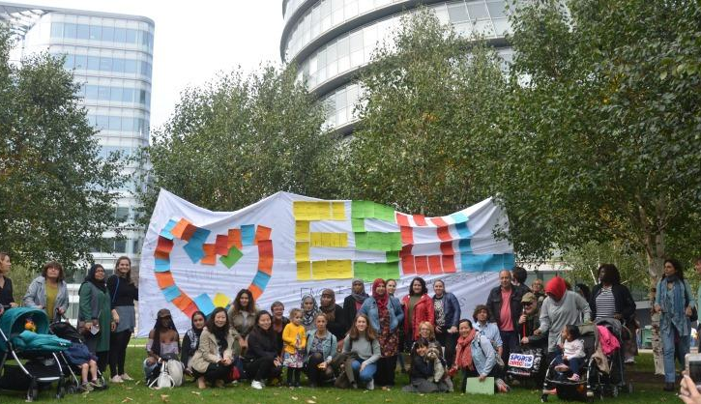
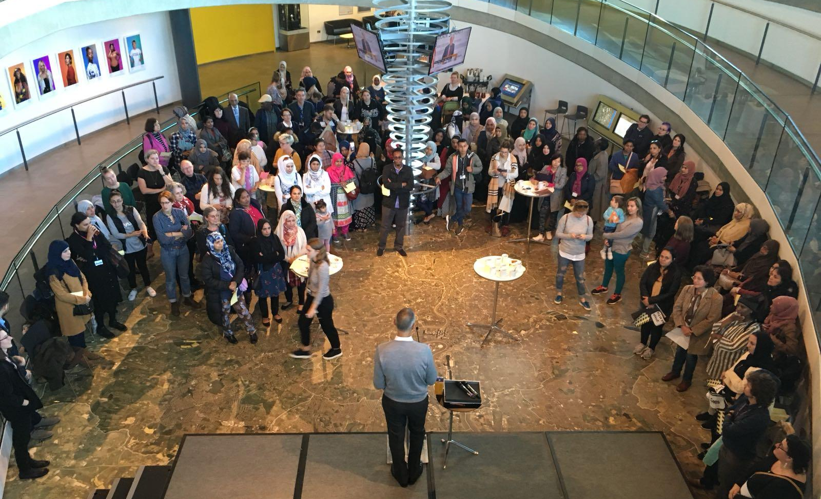
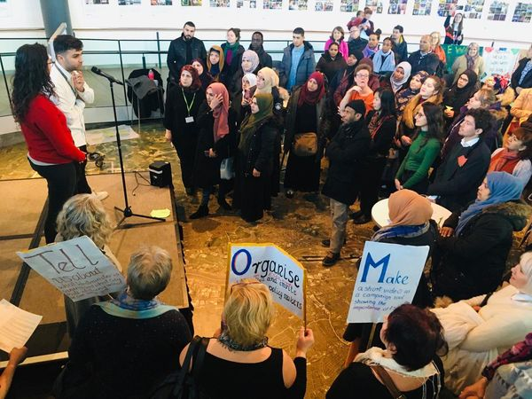
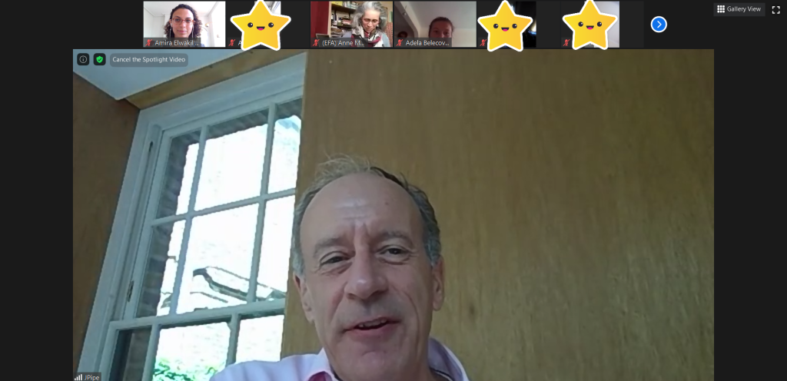
#LoveESOL assemblies with GLA
2017
2018
Feb 2020
Sept 2020
Notes:
Since then we have held these meetings annually and engaged with deputy mayors of both GLA departments with responsibility for ESOL in London, Debbie Weekes Barnard from the social integration department as well as her predecessor Matthew Ryder and Jules Pipe from the Skills department as well as senior policy officers in these departments.
The events were co-organised and attended ESOL students and teachers from a number of organisations as well as other allied organisations who care about ESOL. Each event had around 200 people in attendance.
At these meetings ESOL students shared their experiences of learning English and the barriers they experienced while doing so.
At these assemblies but also in classes we have been hearing that one of the major barriers experienced by ESOL students is a lack of information about classes. We have heard students talk about having to stay at home for years because they could not find a class with a creche or they were prevented from attending one because they did not have meet certain eligibility criteria. With ESOL funding cut by more than a half, many students are put on waiting lists. All of this could be mitigated by having a website with ESOL classes in London.

Slide 23
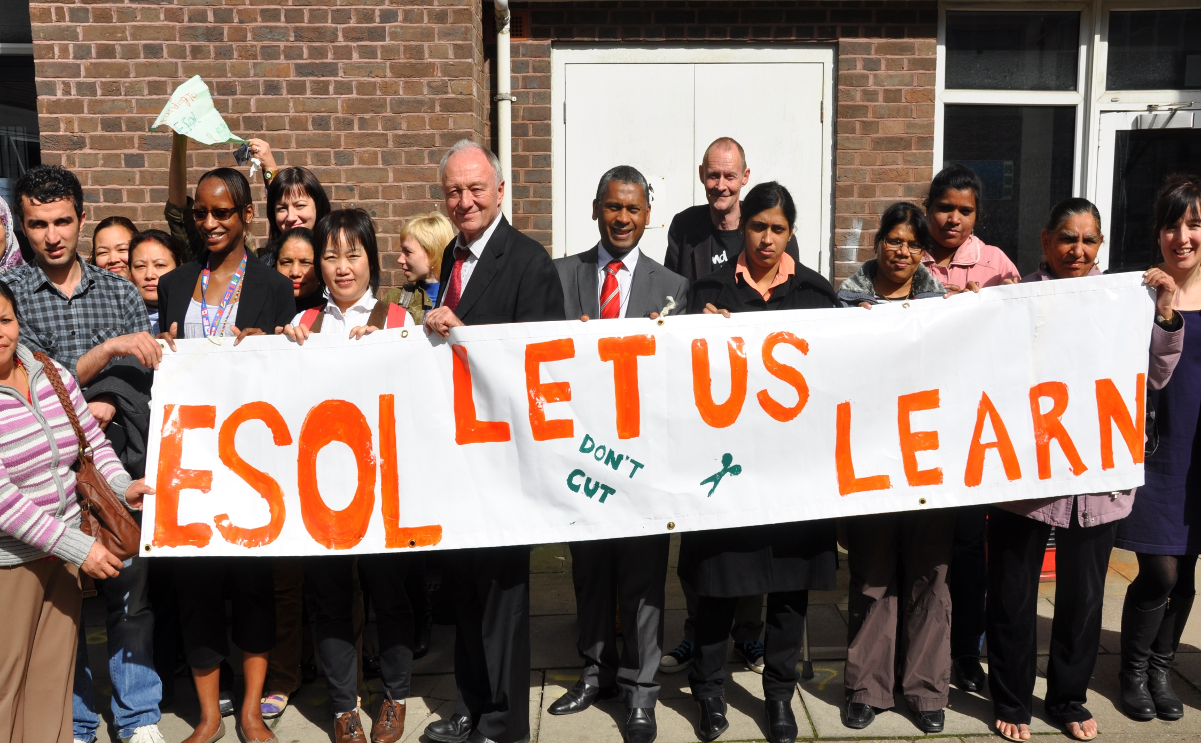
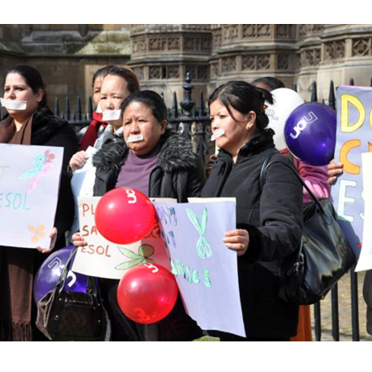
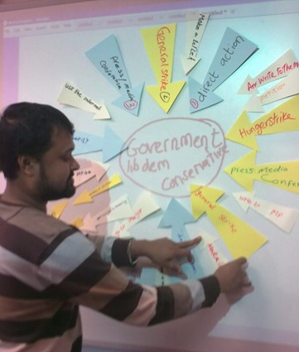
The Action for ESOL campaign (2011)

Slide 24
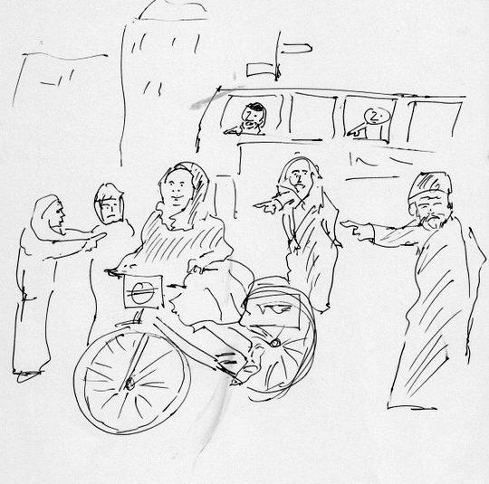
Acts of citizenship in the classroom
The Whose Integration Project (2013)

Slide 25
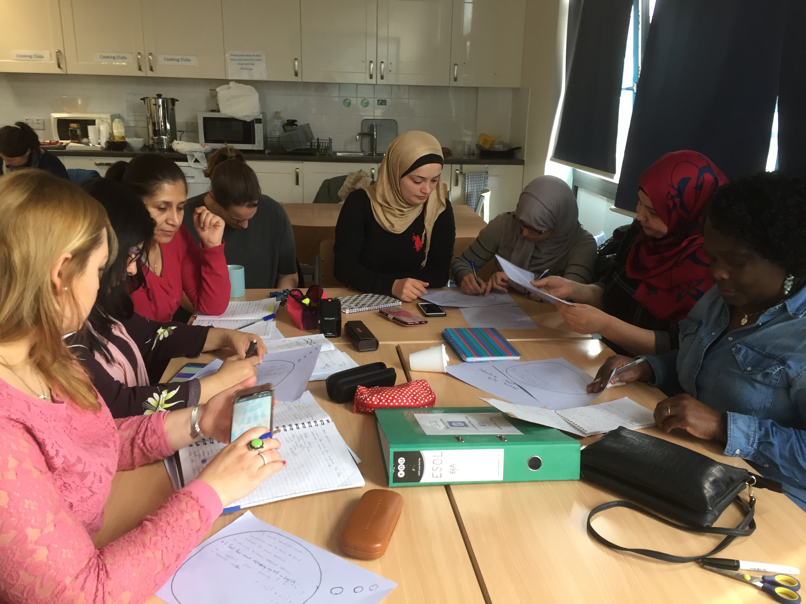
Our Languages (2019)
Classroom based project explored sociolinguistic knowledge with ESOL learners
Participatory lessons about:
language policies
bi/multilingualism
linguistic repertoires
heritage language learning
family language policies
language discrimination
mono vs multilingualism in language classrooms
Participatory approaches included:
problem posing using visual codes
forum theatre (Agosto Boal’s Theatre of the Oppressed)

Slide 26
Activity: your linguistic repertoires
your main/strongest language/variety
a language you speak well which you learned as an adult
a language you can speak ‘a bit’
a language you can understand but not speak very well
a language you can read but not speak
a language you mix with another one
a language you feel an emotional attachment to
a language you have negative feelings about

Slide 27
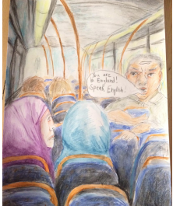
Tackling language discrimination
Problem posing using visual codes
Describe the picture.
Recognise the problem.
Identify with the problem.
Explore the root causes, social aspects of the problem.
Look at alternatives/ways of changing.

Slide 28
Forum Theatre
Exploring acts of citizenship through the medium of art offers the opportunity to imagine scenarios which move against the habitus of general culture
Rehearsal for real life (Boal)
Students produced plays using experiences from their own lives to develop as improvised performances.
They performed these plays taking on different roles and experimenting with different ways of dealing with experiences of language discrimination
Students were able to imagine a different reality in the safe space of the classroom with opportunities to discuss pros and cons of different actions, thus envisaging an alternative reality in which multilingualism has respect and recognition in the public sphere

Slide 29
Our Languages: reflections
Students were able to access and contribute to complex discussions about language.
Students (and researchers) increased awareness of the importance of their whole repertoire
Students (and researchers) became more aware of their own language ideologies and those around them.
They allowed their multilingual identities to become more prominent.
They were able to recognise and name language-based discrimination and rehearse ways of resisting it in future.
They got directly involved in campaigning, developing links between language and political action.

Slide 30
Our Languages: final remarks
The ‘Our Languages’ project showed how linguistic citizenship can be fostered in an educational setting, in its exploration of language as a political and economic site of struggle and the respect for language diversity it fostered amongst students and teacher-researchers alike.
Committed, learner responsive language education must be one arena in which at least some measures might be taken to offset the worst consequences of the exclusion, silencing and marginalisation suffered by many migrant speakers of languages other than English.

Slide 31
Future developments
Develop a teacher training programme incorporating the ideas discussed here
Draw together a coalition of people from across language education (primary, secondary, adult, HE, modern foreign languages, ESOL, complementary schools) in an attempt to promote some of our ideas on a national scale – and maybe even influencing future policy
Watch this space!!!

Slide 32
REFERENCES
Awayed-Bishara, M. 2021. Linguistic citizenship in the EFL classroom: Granting the local a voice through English. TESOL Quarterly 55/3:743-765
Bourdieu, P. (1976) The economics of linguistic exchanges. Social Science Information 1977 16: 645-668
Bryers, D., Winstanley, B., and Cooke, M. (2013) Whose Integration? ESOL Nexus, British Council. Available at http://esol.britishcouncil.org/sites/esol/files/Whose%20Integration2.pdf
Cooke, M. and Peutrell, R. (eds.) (2019) Brokering Britain, Educating Citizens: Exploring ESOL and Citizenship Bristol: Multilingual Matters
Cooke, M., Bryers, D. and Winstanley, B. (2019) ‘”Our Languages”: Towards Sociolinguistic Citizenship in ESOL’ in Cooke, M. and Peutrell, R. (eds.) (2019) Brokering Britain, Educating Citizens: Exploring ESOL and Citizenship Bristol: Multilingual Matters (137-157)
Ercel, E. (2008) ‘Spike Lee’s 25th Hour’ in in Isin F.E. and G.M. Nielsen (eds.) (2008) Acts of Citizenship. New York: Zed Books (297-299)
Gspandl, J. C. Korb, A. Heiling & E. Erling (eds.) 2023. The Power of Voice in Transforming Multilingual Societies. Bristol: Multilingual Matters
Hymes, D. 1977. Foundations in Sociolinguistics: An Ethnographic Approach. London: Tavistock
Lim, L., C. Stroud & L. Wee (eds) 2018. The Multilingual Citizen: Towards a Politics of Language for Agency and Change. Bristol: Multilingual Matters. 40-64
Isin, F.E. (2008) ‘Theorising Acts of Citizenship’ in Isin F.E. and G.M. Nielsen (eds.) (2008) Acts of Citizenship. New York: Zed Books (15-44)
Pothier, D and R. Devlin (eds.) (2006) Critical Disability Theory: Essays in Philosophy, Politics, Policy and Law. Vancouver: UBC Press
Ramanathan, V. (2013) Language Policies and (Dis)Citizenship: Rights, Access, Pedagogies. Bristol: Multilingual Matters
Rampton, B, Cooke, M, Bryers, D., Winstanley, B., Leung, C., Tomei, A., & Holmes, S (forthcoming) Localising Linguistic Citizenship in England, Language Teaching.
Santos, B de S. (2012) Public sphere and epistemologies of the South. Africa Development 37 (1), 43-67
Stroud, C. (2001) African mother tongue programs and the politics of language: linguistic citizenship versus linguistic human rights. Journal of Multilingual and Multicultural Development 22 (4): 339–355.
Stroud, C. (2018) ‘Linguistic Citizenship’. In L. Lim, C. Stroud and L. Wee (eds) The Multilingual Citizen: Towards a Politics of Language for Agency and Change (pp.17–39). Clevedon: Multilingual Matters.
Stroud, C., and K. Heugh (2004), ‘Linguistic Human Rights and Linguistic Citizenship’, in D. Patrick and J. Freeland (eds), Language Rights and Language Survival: A Sociolinguistic Exploration, 191–218. Manchester: St Jerome.
Williams, Q., and C. Stroud (2015) Linguistic Citizenship: Language and Politics in Postnational Modernities, Journal of Language & Politics, 14 (3): 406–30
Winstanley, B. (2016) Act ESOL: a Theatre of the Oppressed Language Project, Serpentine Gallery Available at: https://www.serpentinegalleries.org/whats-on/act-esol-language-resistance-theatre/
Winstanley, B and M. Cooke (2016) Emerging Worlds: The Participatory ESOL Planning Project, Paper 4 Literacy. Available at: https://efalondon.org/research/

Slide 33
Discussion
Questions for me?
How does all this apply to your contexts?

